Slide 1
Further
Approximation algorithms
MA428 – CO7

Slide 2
Approximation Algorithms
Greedy algorithms:
  k-center problem
  metric TSP
Randomized Algorithms:
  Maximum Satisfiability Problem (MAX SAT)
  Maximum Cut Problem (MAX CUT)

Slide 3
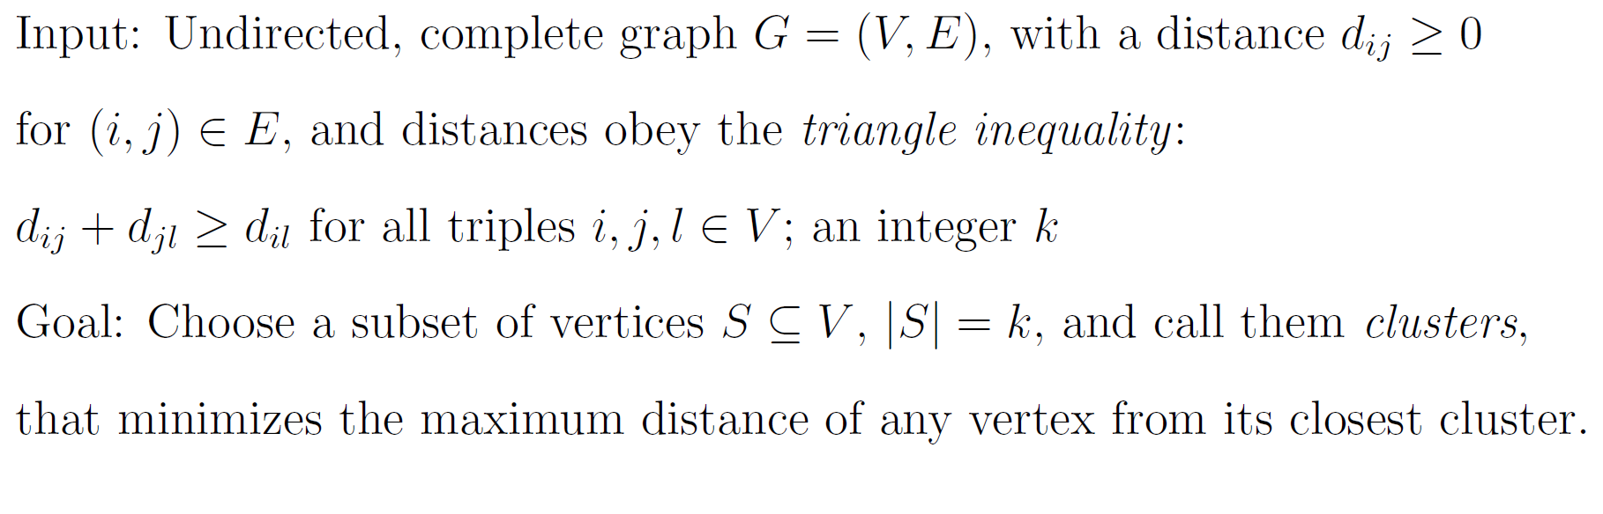
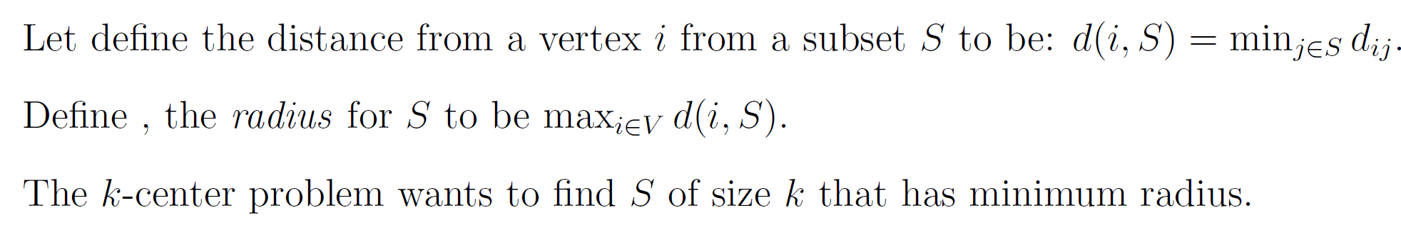
Approximation Algorithms - Greedy
k-center problem

Slide 4
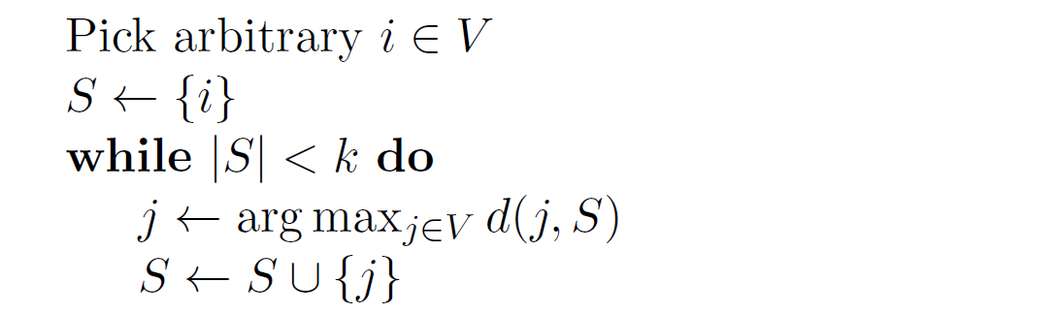
Approximation Algorithms - Greedy
A greedy 2-approximation algorithm for the k-center problem

Slide 5
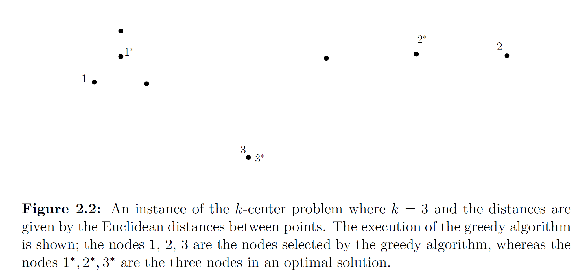
Approximation Algorithms - Greedy
A greedy 2-approximation algorithm for the k-center problem

Slide 6
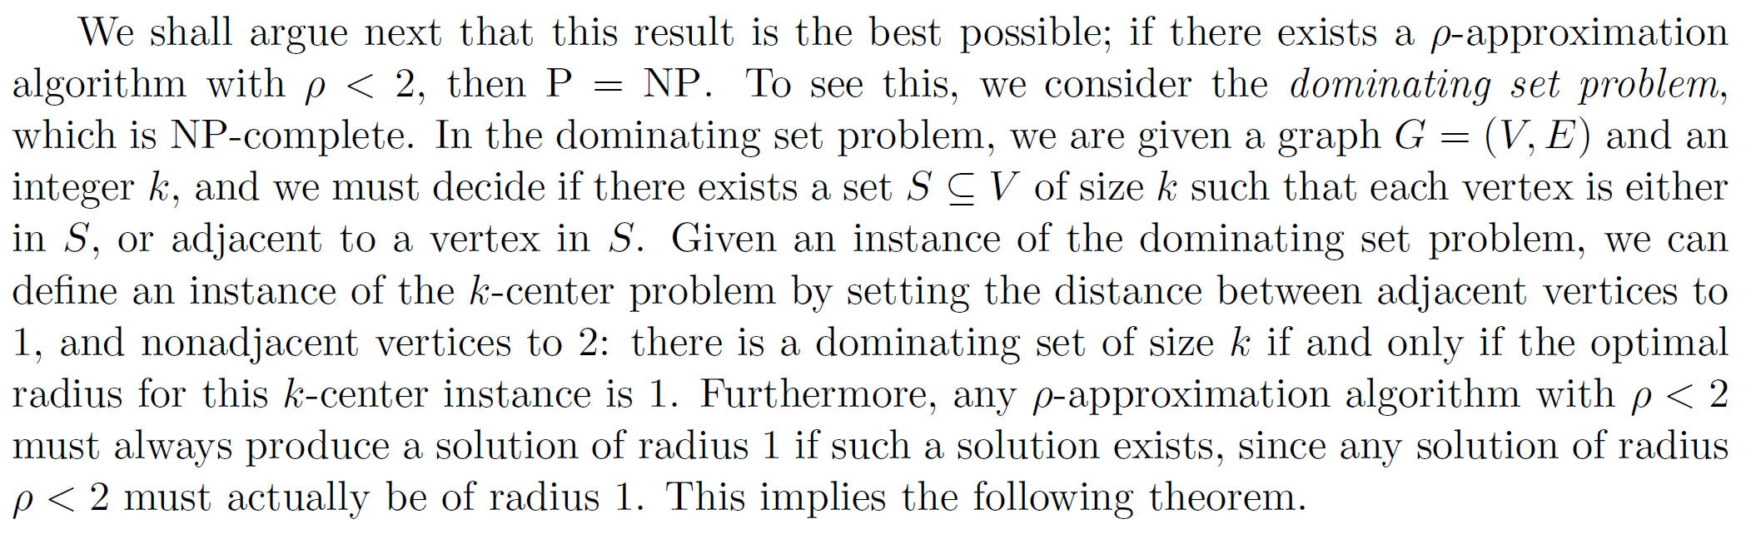
Approximation Algorithms - Greedy
approximation algorithms for the k-center problem

Slide 7
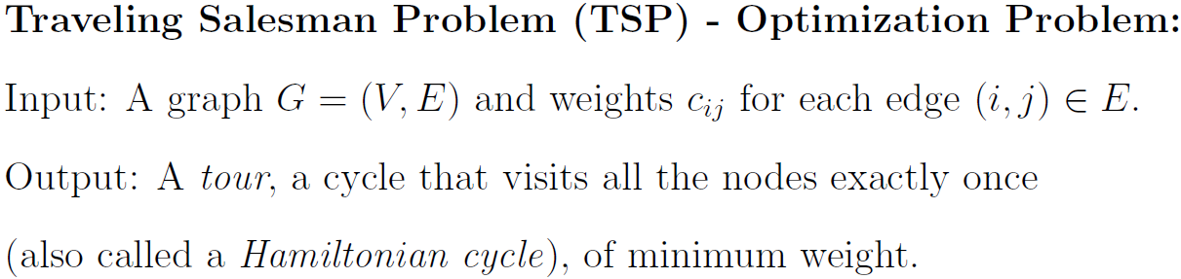
Approximation Algorithms -Greedy
Travelling Salesman Problem
Consider the Travelling Salesman Problem on a complete graph G = (V,E)
Hamiltonian Cycle Problem
The Hamiltonian cycle problem is NP-complete

Slide 8
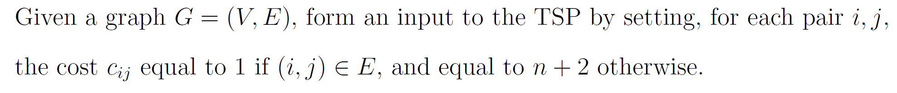
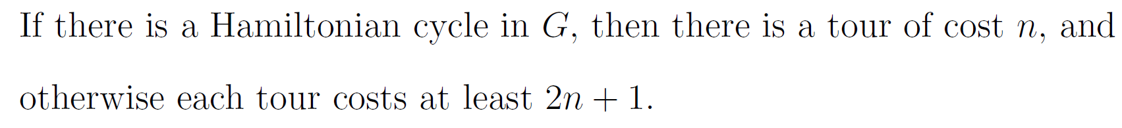
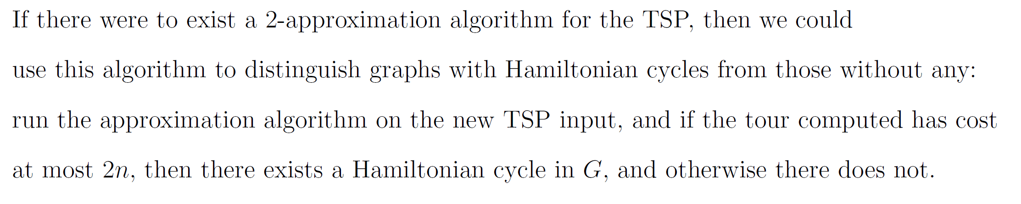
Approximation Algorithms - Greedy
An α-approximation to the TSP could solve the Hamiltonian Cycle problem

Slide 9
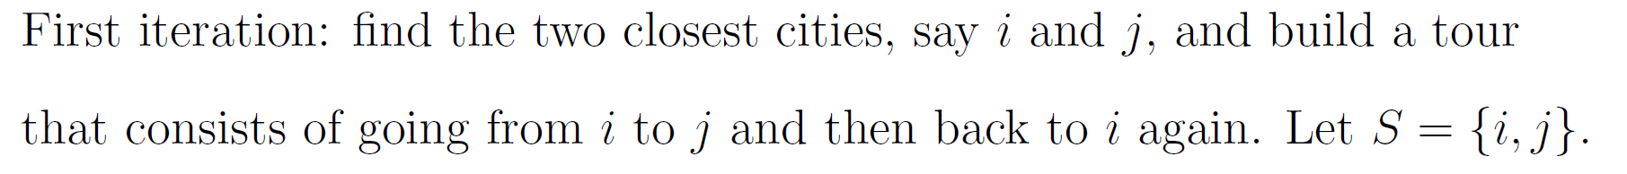
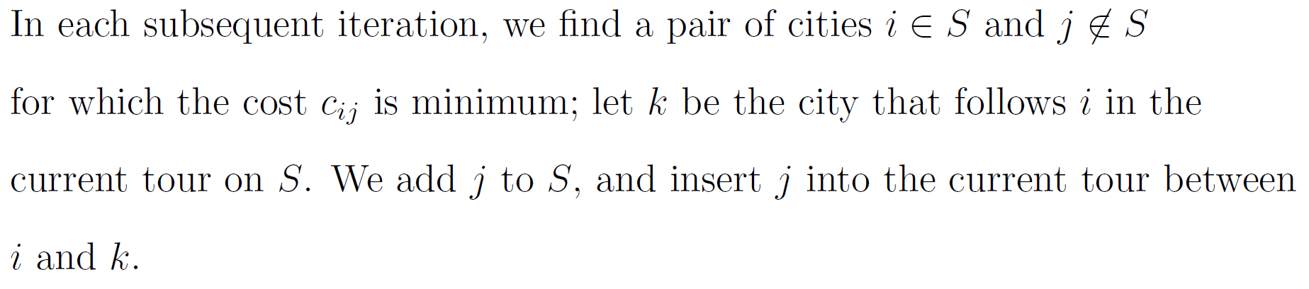
Approximation Algorithms - Greedy
Metric Travelling Salesman Problem
Nearest Addition Algorithm for the Metric TSP

Slide 10
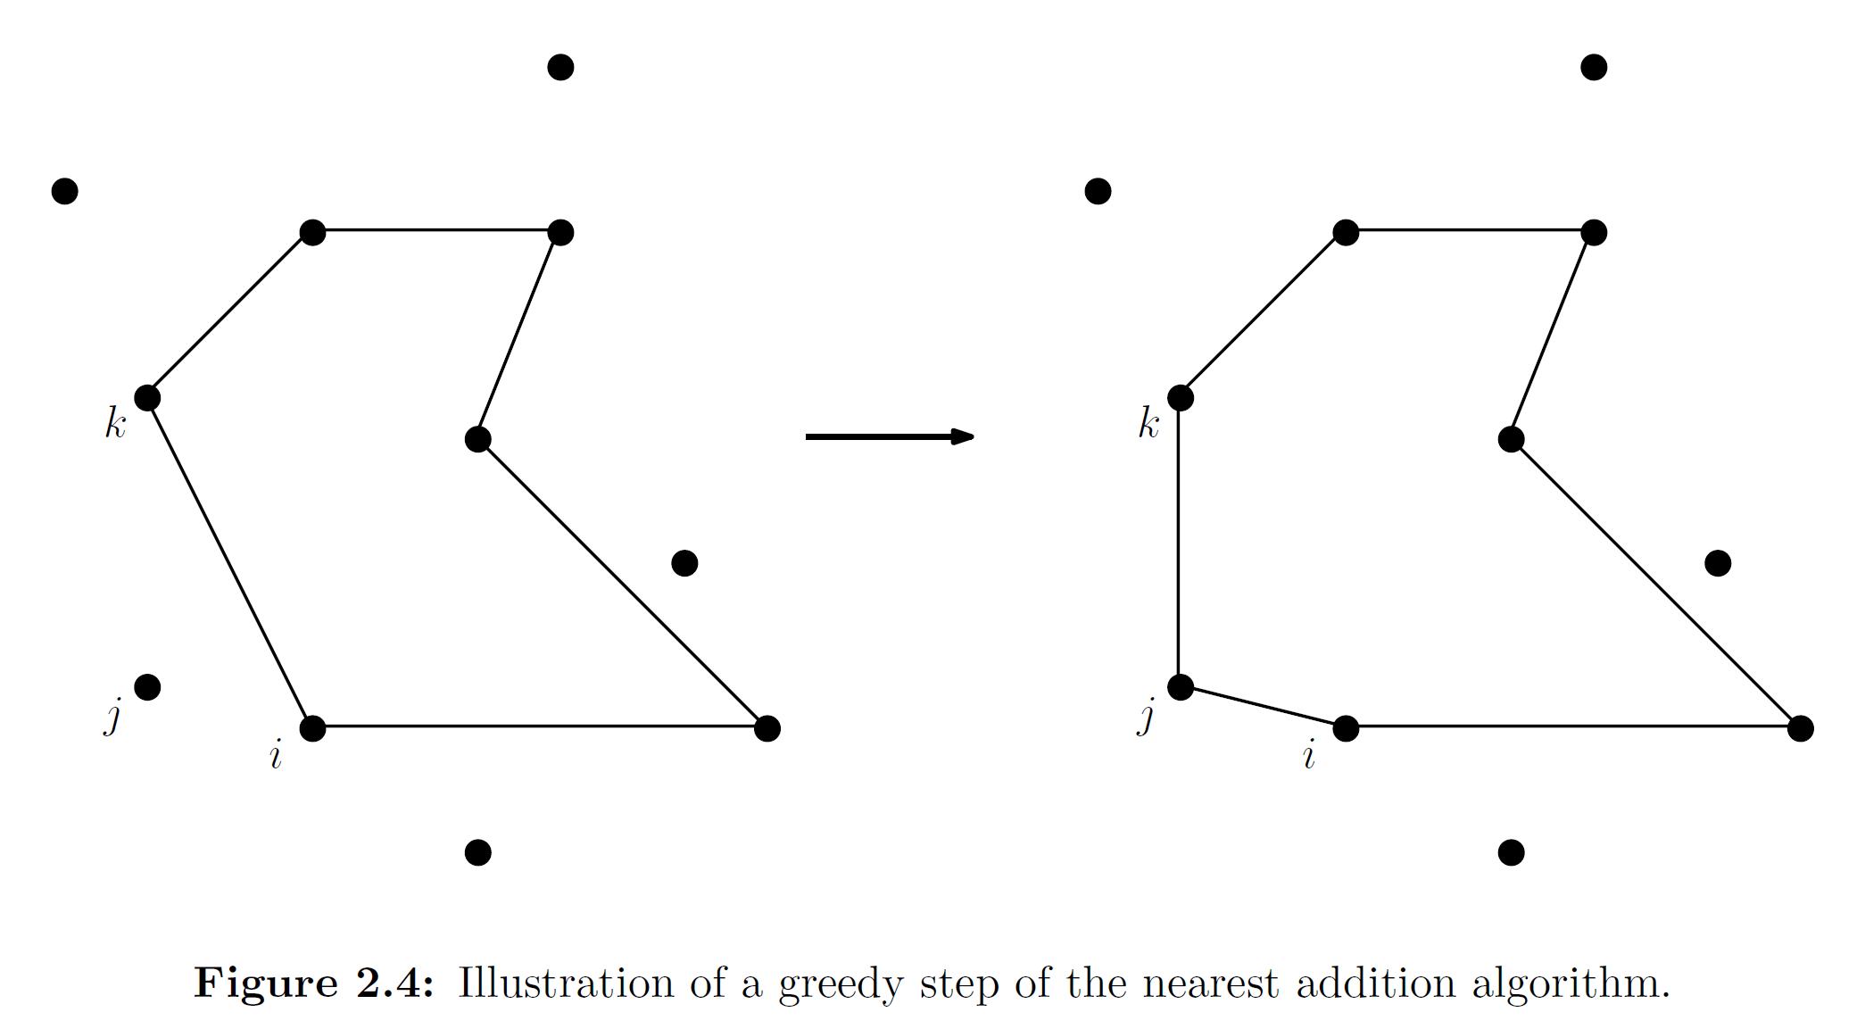
Approximation Algorithms - Greedy
Nearest Addition Algorithm for the Metric TSP

Slide 11
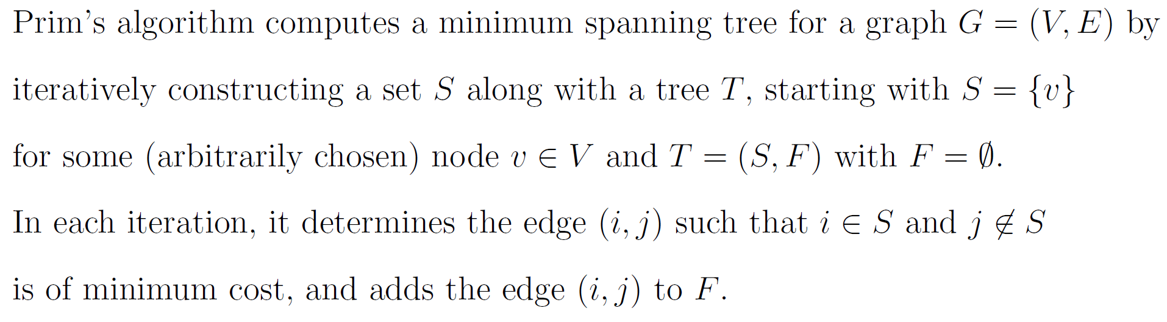
Approximation Algorithms - Greedy
Nearest Addition Algorithm for the Metric TSP
Prim’s Algorithm for Minimum Spanning Trees

Slide 12
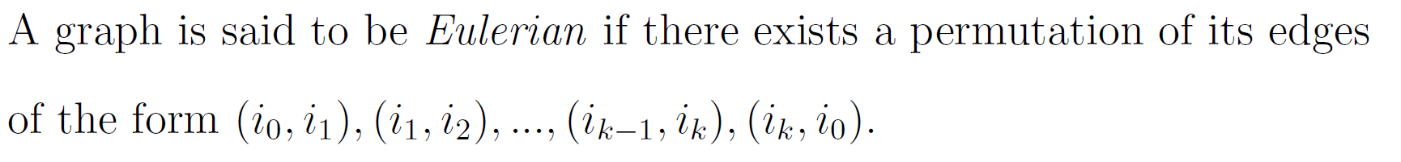
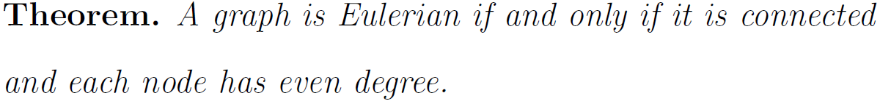
Approximation Algorithms -Greedy
Eulerian graphs

Slide 13
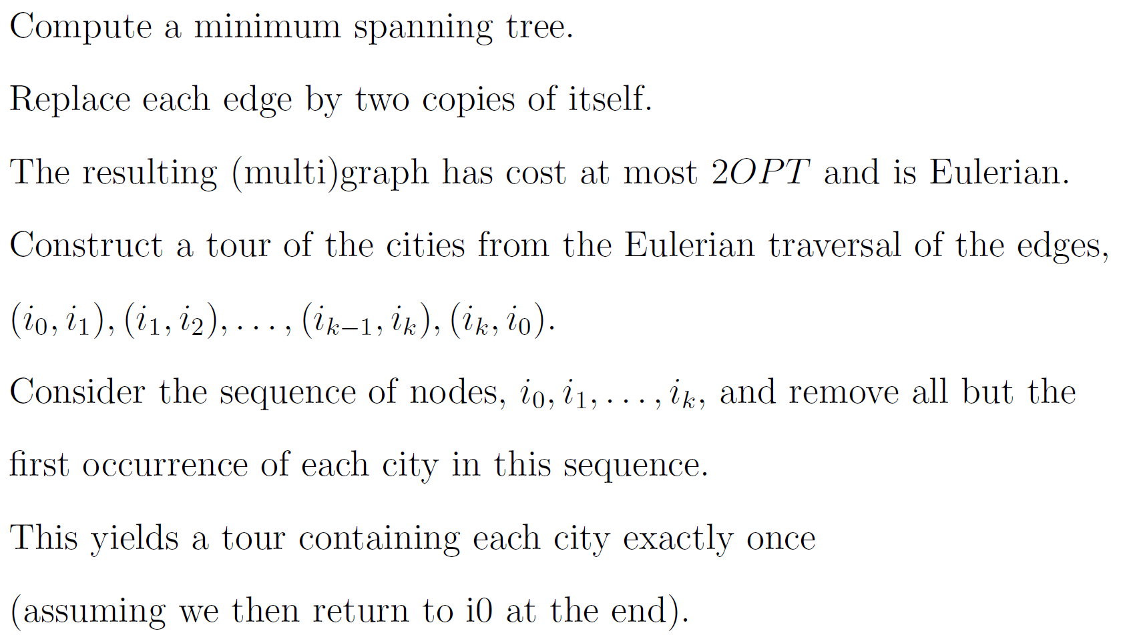
Approximation Algorithms -Greedy
Double -tree Algorithm for the Metric TSP

Slide 14
Approximation Algorithms -Greedy
Double -tree Algorithm for the Metric TSP
a
2
2
1
4
e
2
b
3
2
1
5
3
d
c

Slide 15
Approximation Algorithms -Greedy
Double -tree Algorithm for the Metric TSP
a
2
2
1
4
e
2
b
3
2
1
5
3
d
c

Slide 16
Approximation Algorithms -Greedy
Double -tree Algorithm for the Metric TSP
a
2
2
1
4
e
2
b
3
2
1
5
3
d
c
a,b,e,c,e,d,e,b,a

Slide 17
Approximation Algorithms -Greedy
Double -tree Algorithm for the Metric TSP
a
2
2
1
4
e
2
b
3
2
1
5
3
d
c
a,b,e,c,e,d,e,b,a

Slide 18
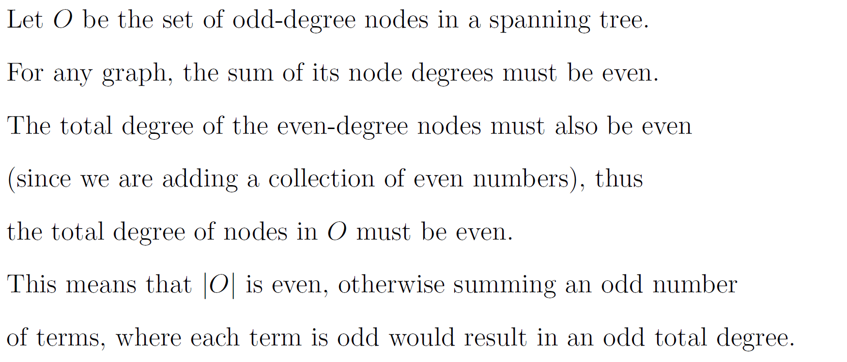
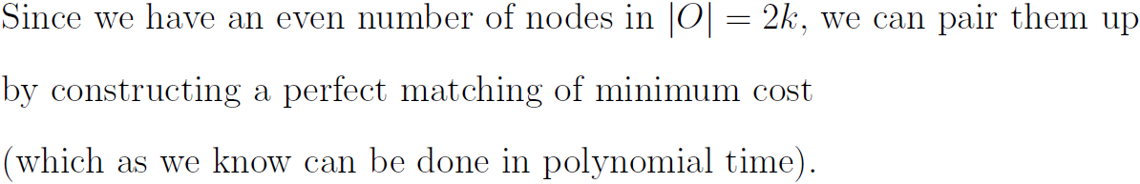
Approximation Algorithms - Greedy
Degree of nodes in a Spanning Tree

Slide 19
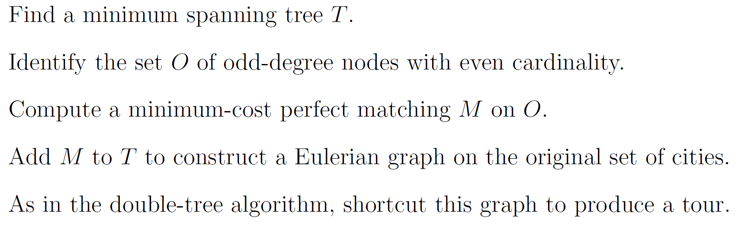
Approximation Algorithms - Greedy
Christofides Algorithm for the Metric TSP

Slide 20
Approximation Algorithms -Greedy
Christofides Algorithm for the Metric TSP
a
2
2
1
4
e
2
b
3
2
1
5
3
d
c

Slide 21
Approximation Algorithms -Greedy
Christofides Algorithm for the Metric TSP
a
2
2
1
4
e
2
b
3
2
1
5
3
d
c

Slide 22
Approximation Algorithms -Greedy
Christofides Algorithm for the Metric TSP
a
2
2
1
4
e
2
b
3
2
1
5
3
d
c
a,e,d,c,e,b,a

Slide 23
Approximation Algorithms -Greedy
Christofides Algorithm for the Metric TSP
a
2
2
1
4
e
2
b
3
2
1
5
3
d
c
a,e,d,c,e,b,a

Slide 24
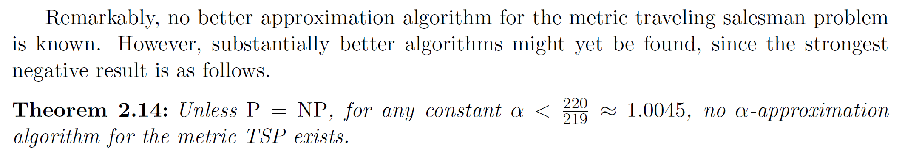
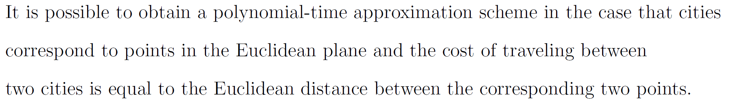
Approximation Algorithms - Greedy
Approximation Algorithms for the Metric TSP

Slide 25
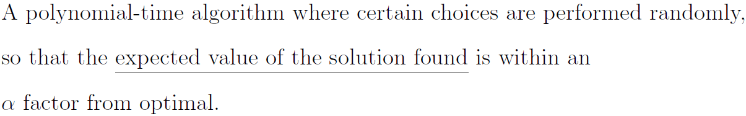
Approximation Algorithms - Randomized
Randomized approximation algorithm

Slide 26
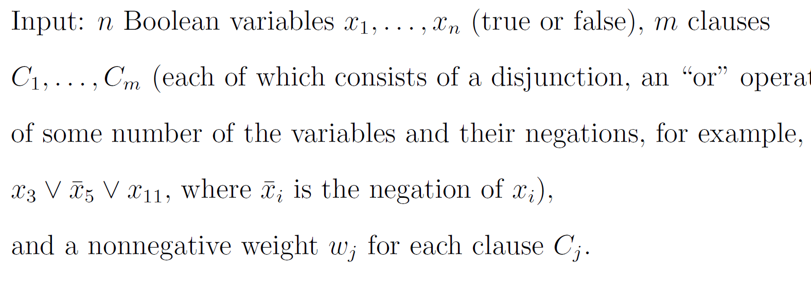
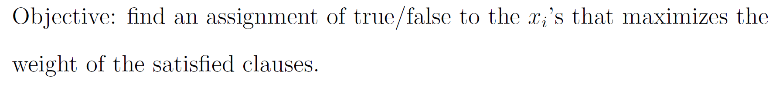
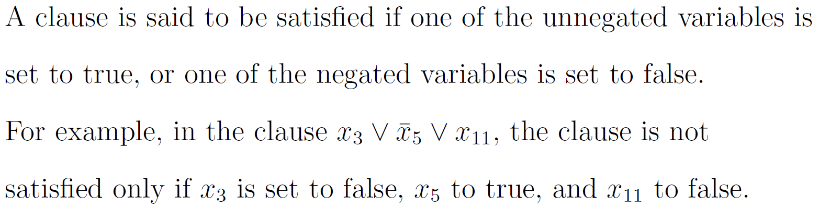
Approximation Algorithms - Randomized
Maximum Satisfiability Problem (MAX SAT)

Slide 27
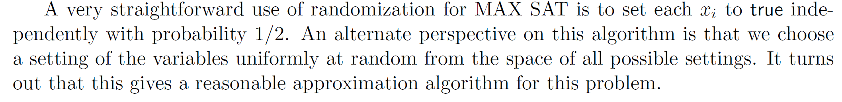
Approximation Algorithms - Randomized
Randomized approximation algorithm for the MAX SAT problem

Slide 28
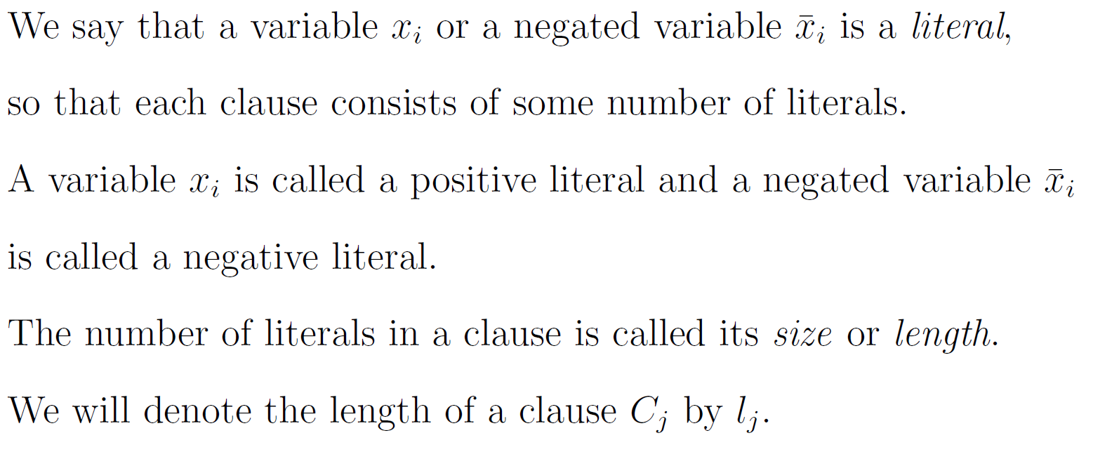
Approximation Algorithms - Randomized
Some terminology for the MAX SAT Problem
MAX E3SAT Problem

Slide 29
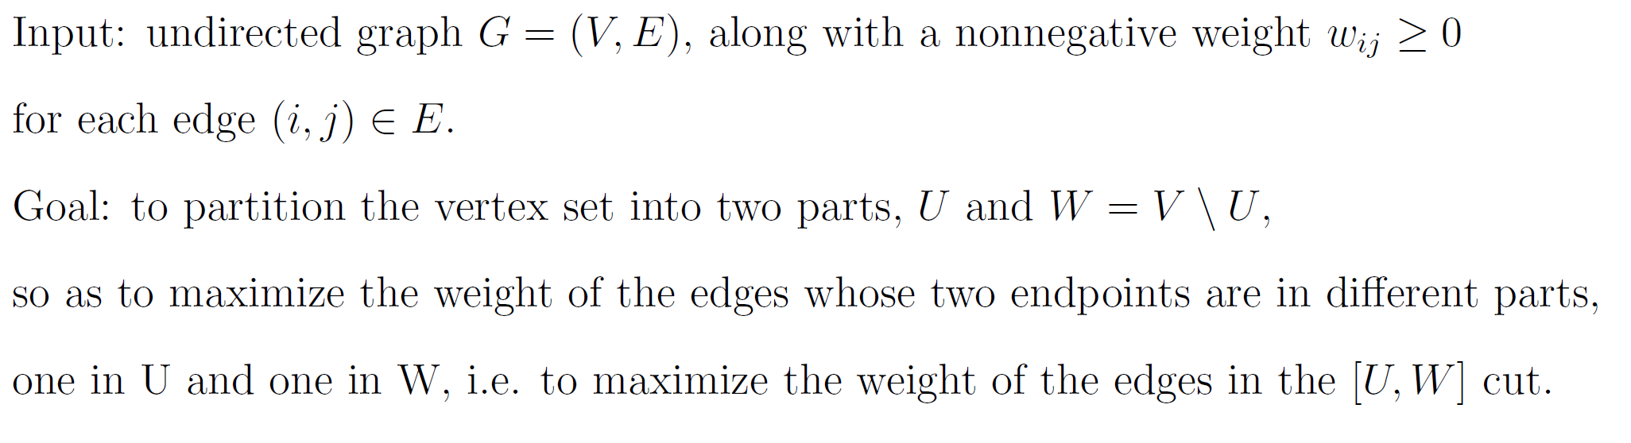
Approximation Algorithms - Randomized
Maximum Cut Problem (MAX CUT)

Slide 30
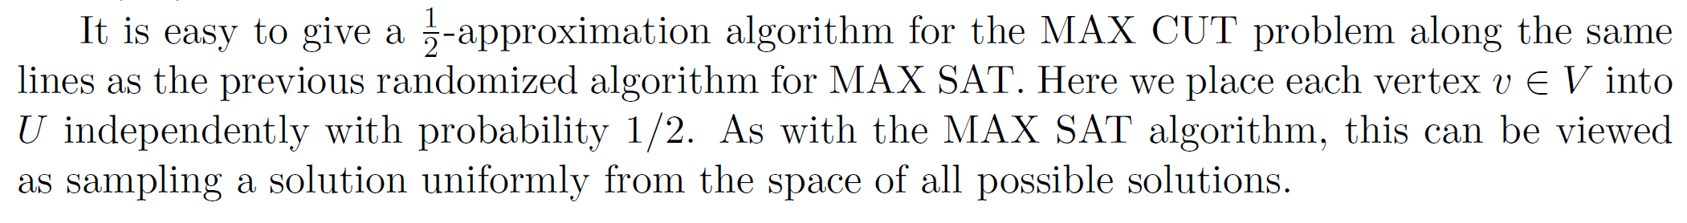
Approximation Algorithms - Randomized
Randomized approximation algorithm for the MAX CUT problem

